Slide 1
CADSQUAD NEW WEBSITE IDEA
Revision: 00
Presenter: Phong Pham

Slide 2
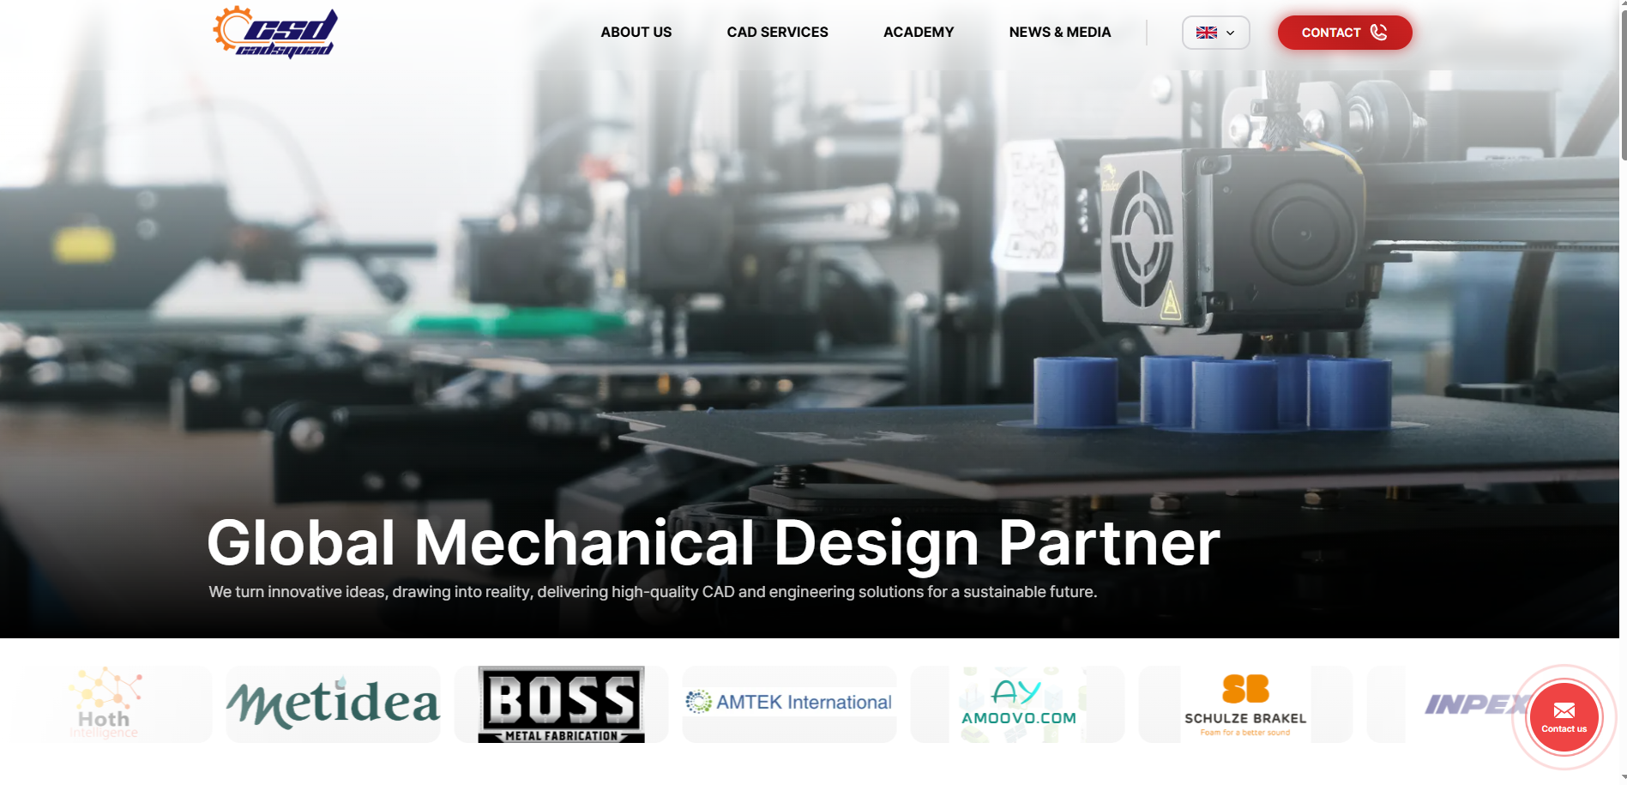
Home
DIGITAL SERVICVES
AFFILIATE
Global Engineering Partner
Transforming engineering ideas into reliable, real-world solutions.

Slide 3
Home
DIGITAL SERVICES
AFFILIATE
Global Digital Engineering Partner
Designing smart, scalable websites for modern businesses.

Slide 4
Home
DIGITAL SERVICES
AFFILIATE
Engineering Learning Partner
Empowering engineers through practical knowledge and industry-driven training.

Slide 5
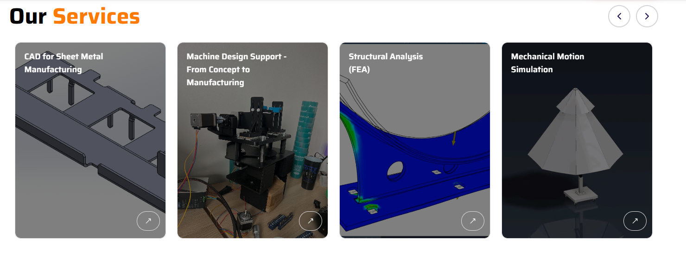
Home
CAD Services

Slide 6
Home
Digital Services
Phần này Show services bên CSD DIGITAL

Slide 7
Home
Learning Courses
Phần này Show Courses bên CSD ACADEMY

Slide 8
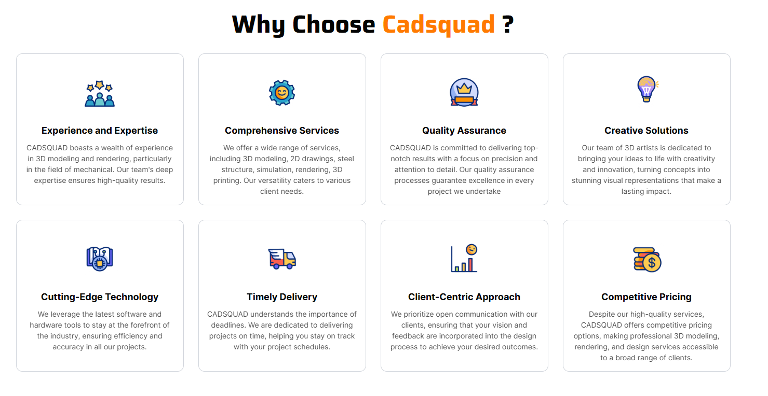
Home
Our Services
Integrated Expertise
Industry-Driven Knowledge
End-to-End Solutions
Innovation & Technology
We bring together engineering excellence, professional education, and digital innovation to deliver comprehensive solutions under one unified ecosystem.
Our services are built on real-world project experience and practical insights, ensuring relevance, efficiency, and measurable impact across every engagement.
We leverage advanced tools, modern methodologies, and evolving technologies to create forward-thinking solutions in design, training, and digital development.
From concept development and execution to training and implementation, we support our clients at every stage of their journey.
Scalable Partnership
We grow with our clients. Whether supporting startups, SMEs, or expanding enterprises, our solutions are designed to scale alongside your ambitions.
We follow a clear workflow, milestone tracking, and proactive communication to ensure every engineering project, training program, and digital solution is delivered on schedule without compromising quality.
We listen first. Every solution is tailored to our clients’ specific goals, technical requirements, and growth strategy, whether in engineering design, professional training, or digital development.
We optimize resources and processes to provide high-quality services at competitive and sustainable pricing, delivering measurable value for every investment.

Slide 9
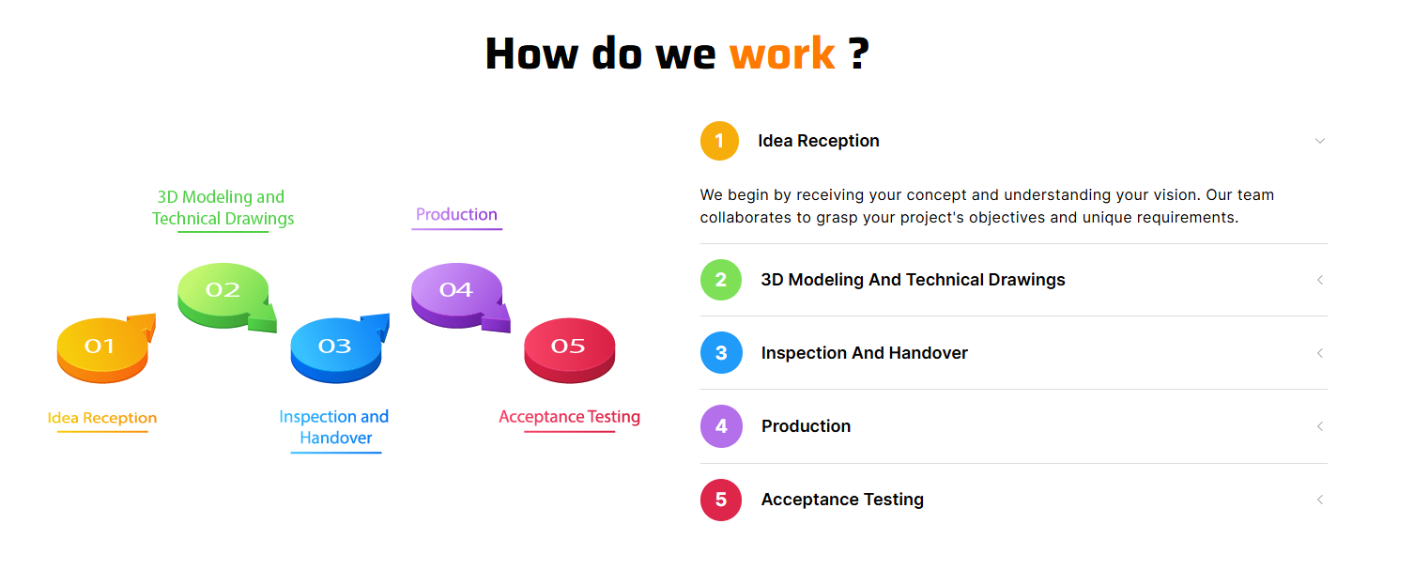
Home
1. Discover & Understand
We begin by understanding your goals, technical requirements, and long-term vision to ensure full alignment from the start.
2. Analyze & Strategize
Our team evaluates the scope, defines clear objectives, and builds a structured roadmap tailored to your needs.
3. Execute with Precision
Through disciplined workflows and milestone tracking, we deliver engineering, training, or digital solutions with accuracy and efficiency.
4. Review & Optimize
We conduct thorough reviews, quality checks, and refinements to ensure the highest standards are met.
5. Deliver & Support
Beyond delivery, we provide guidance, documentation, and ongoing support to ensure sustainable success.

Slide 10
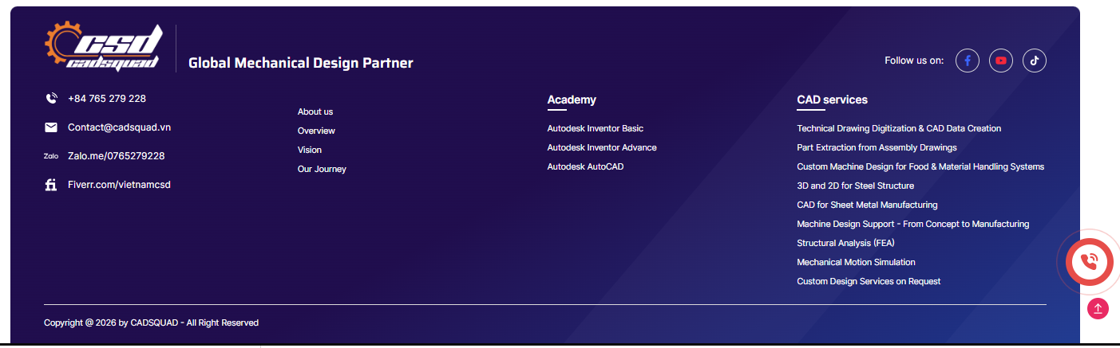
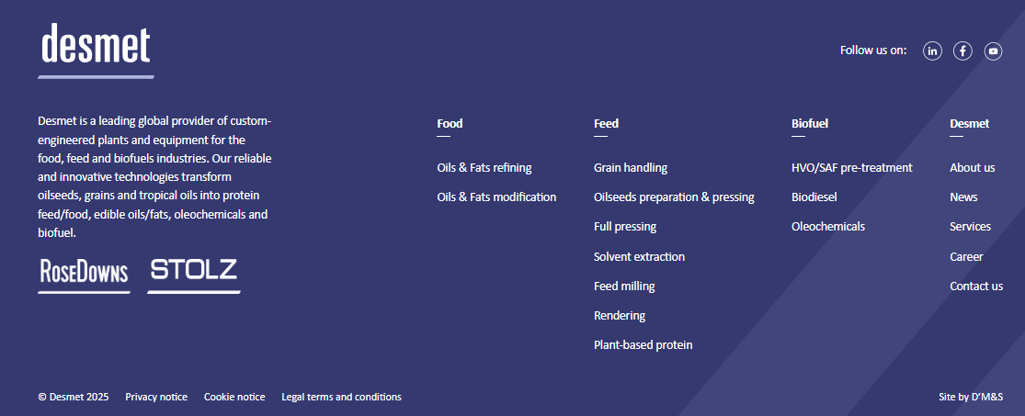
Home
Global Engineering Partner
Digital
Logo Trắng CSD- DIGITAL
Logo Trắng CSD- ACADEMY

Slide 11
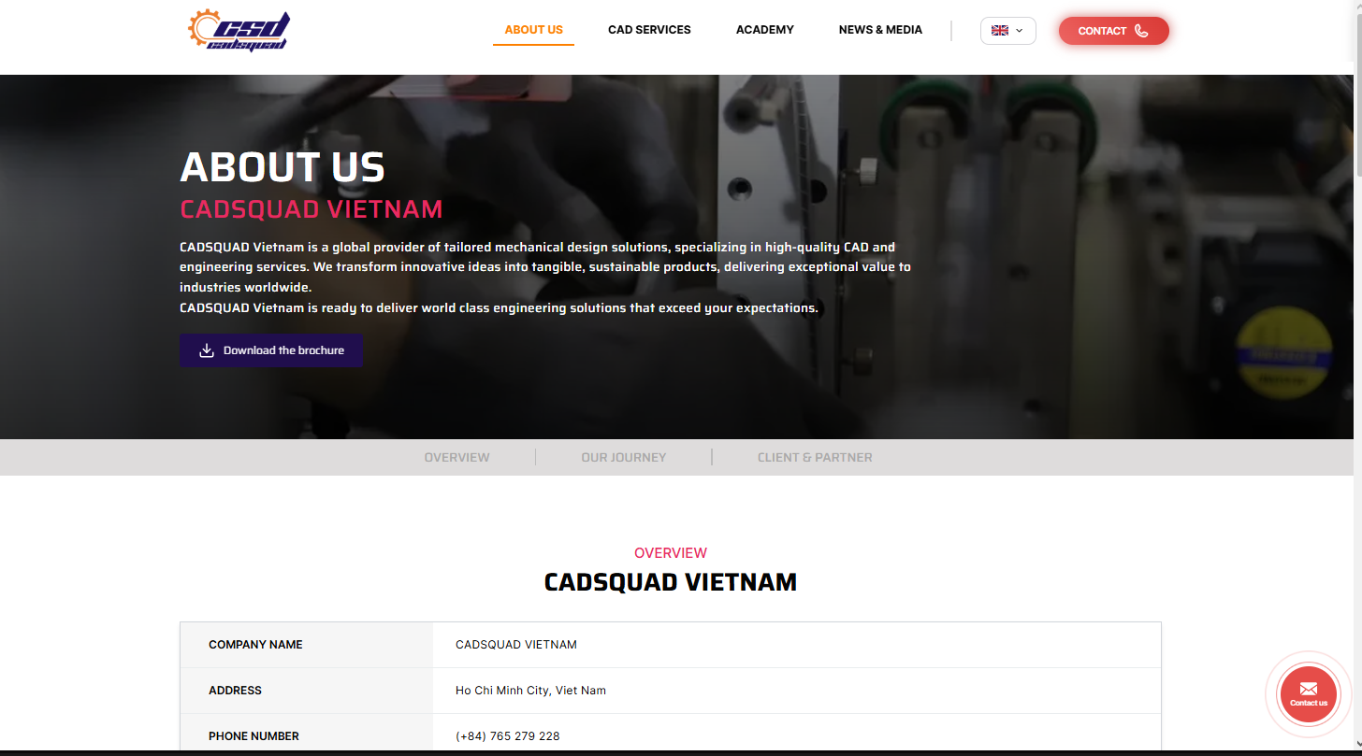
About Us
CADSQUAD Vietnam is a global provider of integrated design, engineering, education, and digital solutions. We specialize in high-quality CAD and mechanical engineering services, professional training programs, and innovative digital development services.
Through our expertise in engineering design, creative education, and digital transformation, we empower individuals and businesses to turn ideas into practical, sustainable, and market-ready solutions.

Slide 12
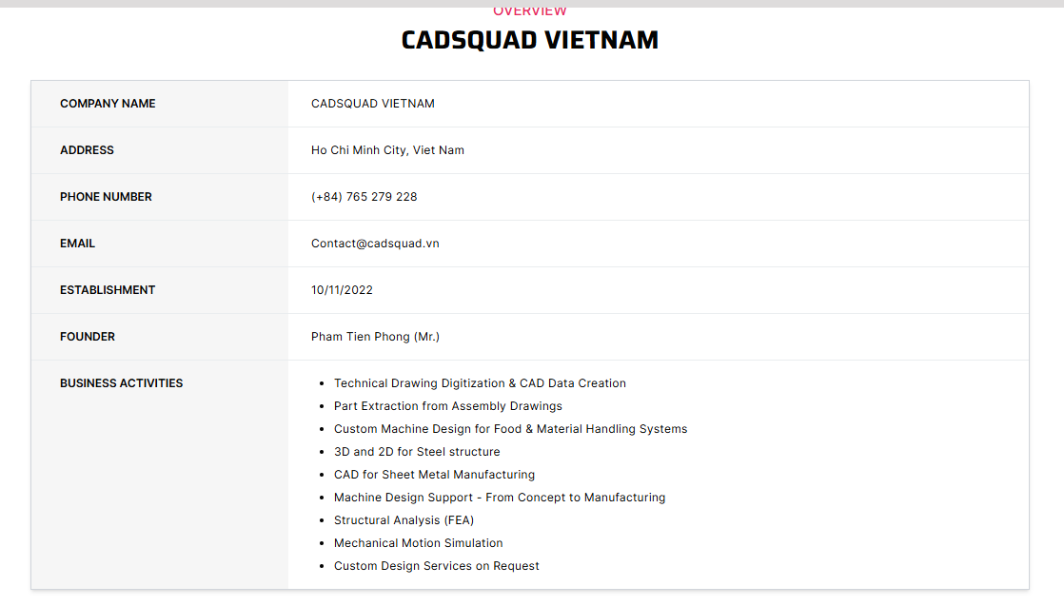
About Us
Our ecosystem
CAD Services
CSD Academy
CSD Digital

Slide 13
About Us
Founder’s Story
Mr. Pham Tien Phong is a mechanical engineer with hands-on experience working for leading corporations in the heavy industry and food processing sectors. Throughout his career, he has been directly involved in machine design, technical documentation, and real-world manufacturing processes—developing a deep understanding of the gap between engineering concepts and practical execution.
Recognizing this gap, he founded CADSQUAD Vietnam with a clear mission: to deliver reliable, high-quality technical solutions while empowering the next generation of engineers and digital creators.
Under his leadership, CADSQUAD has evolved into a multidisciplinary platform that includes:
CAD Services – Mechanical design, CAD data conversion, technical documentation, and engineering support.
CSD Academy – Professional training programs focused on CAD, engineering design, and digital skills.
CSD Digital – Website development and digital solutions that help businesses establish and grow their online presence.
His vision is to build more than a service company—he aims to create a trusted technical ecosystem where innovation, education, and digital transformation come together to turn ideas into real-world, sustainable solutions.
At CADSQUAD Vietnam, we are not just a service provider—we are your long-term technical partner.

Slide 14
About Us
Our Journey
From a small freelance team to a growing multidisciplinary company, our journey reflects resilience, innovation, and an unwavering commitment to excellence.
2022 – Foundation
Founded in Ho Chi Minh City, Vietnam
Started with a small but highly dedicated freelance startup team
Focused on delivering high-quality CAD and mechanical design services to global clients
2023 – 2024 – Global Expansion
Successfully expanded services through international freelance platforms
Built a strong reputation for precision, reliability, and on-time delivery
Established long-term partnerships with clients across multiple industries
2025 – Growth Milestone
Reached over 500 clients worldwide
Successfully completed more than 800 projects, both on freelance platforms and through direct partnerships
Strengthened brand recognition and client trust globally
2026 – Official Establishment & New Era
Officially registered as a legal enterprise
Transitioned from a freelance-driven model to a structured company system
Entered a new era of strategic growth, expanding into education and digital services

Slide 15
About Us
Who We Are
We are a multidisciplinary team of engineers, designers, and digital professionals dedicated to transforming innovative ideas into practical, high-quality solutions.
Our expertise spans:
Engineering & CAD Services – Comprehensive mechanical design, 3D modeling, CAD drafting, and product development tailored to client needs.
CSD Academy – Professional training programs in CAD, engineering, and digital design to empower engineers, students, and creative professionals.
CSD Digital – Website development, digital branding, and online business solutions that help companies thrive in the digital era.
Our vision is to become a trusted partner and leader across engineering design, professional education, and digital services. We achieve this by delivering creativity, reliability, and excellence in every project. By continuously innovating and improving, we ensure every solution we provide brings tangible value and makes a lasting impact for our clients.
With a highly experienced and versatile team, CADSQUAD Vietnam takes pride in offering professional, world-class services that bridge the gap between ideas, skills, and practical execution—whether in engineering, education, or digital solutions.

Slide 16

CAD SERVICES

Slide 17
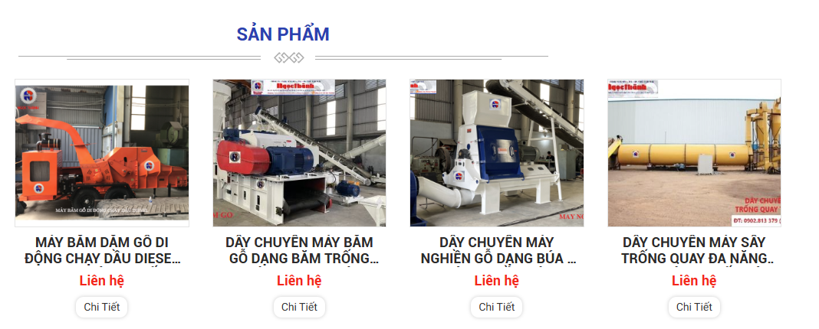
CAD SERVICES

Slide 18
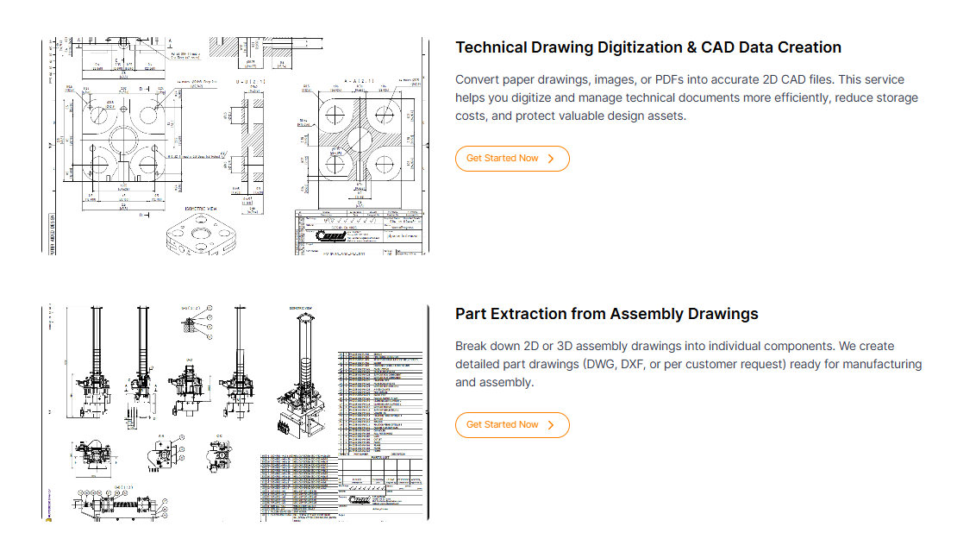
CAD SERVICES

Slide 19
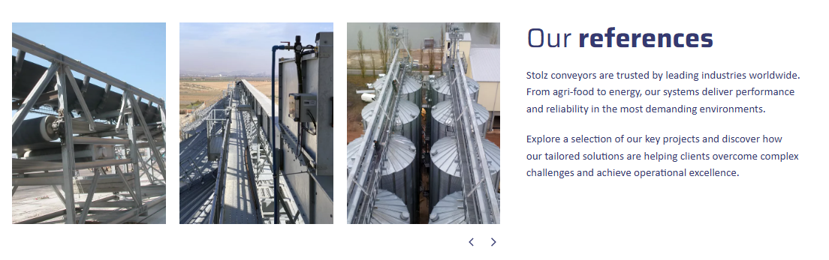
CAD SERVICES
https://www.desmet.com/en/feed/grain-handling/conveyors-and-elevators

Slide 20

DIGITAL SERVICES
CSD DIGITAL
Logo CSD DIGITAL
CSD Digital, the digital solutions arm of CADSQUAD Vietnam, focuses on website development, digital design, and online business solutions. From corporate websites and e-commerce platforms to branding and digital optimization services, CSD Digital delivers comprehensive solutions that help businesses build strong digital identities and achieve sustainable growth in the modern marketplace.

Slide 21
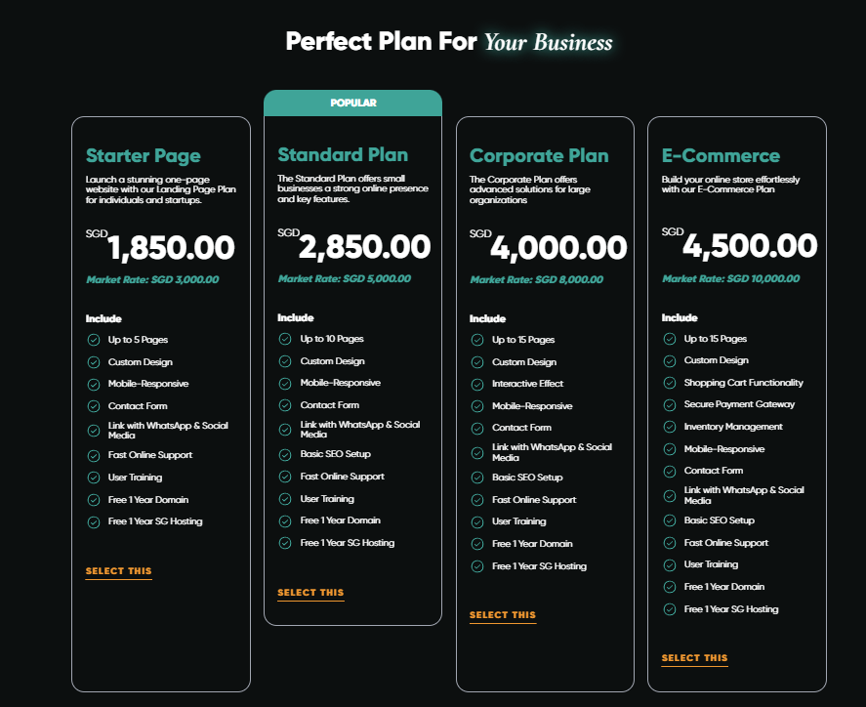
DIGITAL SERVICES

Slide 22
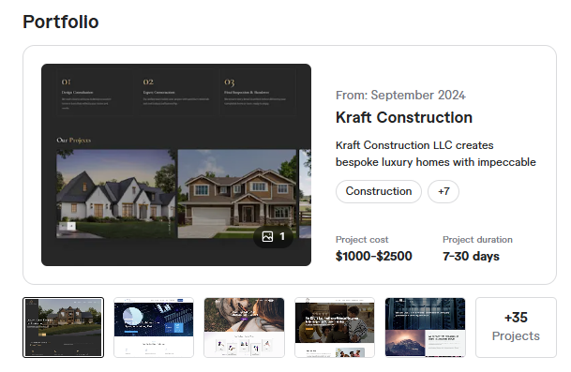
DIGITAL SERVICES

Slide 23
ACADEMY
CSD ACADEMY
Logo CSD ACADEMY
CSD Academy, a professional training division of CADSQUAD Vietnam, is dedicated to developing the next generation of engineers and digital creators. Specializing in CAD design, engineering software, and digital skills training, CSD Academy provides structured, hands-on programs that bridge the gap between theory and real-world application—empowering learners to confidently enter and excel in today’s competitive technical industries.

Slide 24
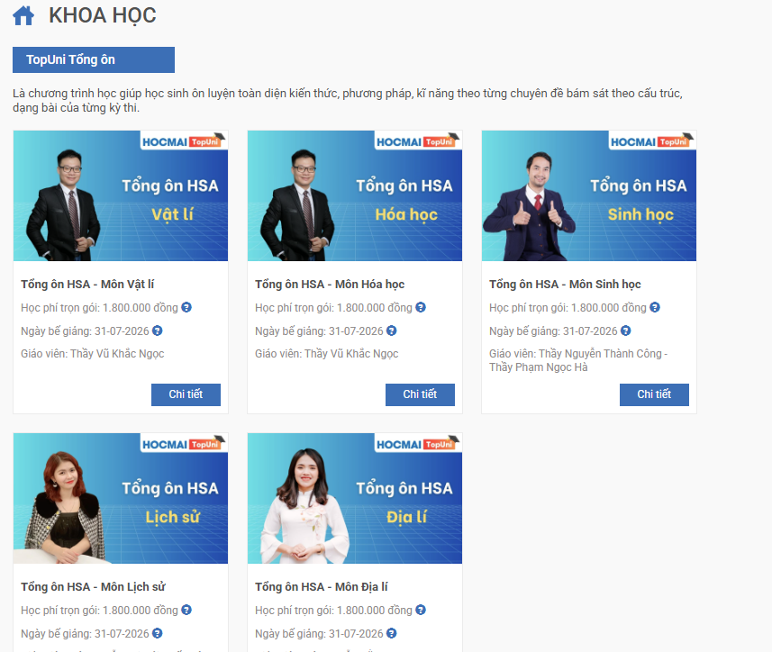
ACADEMY

Slide 25
AFFILIATE
Bạn có khách hàng? Bạn có mối quan hệ trong ngành kỹ thuật, sản xuất, digital? Bạn muốn kiếm thêm thu nhập mà không cần vận hành dự án?
👉 Chỉ cần kết nối – chúng tôi xử lý phần còn lại.
CSD Affiliate Sales Program được thiết kế dành cho những người muốn kiếm thu nhập từ việc giới thiệu khách hàng cho:
CAD Engineering Services
CSD Academy Courses
CSD Digital Website & Online Solutions
Bạn mang khách hàng đến. Chúng tôi triển khai chuyên nghiệp. Bạn nhận hoa hồng xứng đáng.
💼 Cách Thức Hoạt Động
🔹 Bước 1 – Bạn Có Khách Hàng
Bạn chuẩn bị thông tin khách hàng tiềm năng hoặc có nhu cầu thực tế.
🔹 Bước 2 – Gửi Thông Tin Qua Form
Truy cập trang Affiliate Sales và điền form giới thiệu khách hàng.
Hệ thống sẽ tự động gửi về email công ty.
🔹 Bước 3 – Đội Ngũ CSD Liên Hệ
Bộ phận tư vấn sẽ:
Liên hệ trực tiếp khách hàng
Xác nhận nhu cầu
Thiết lập group trao đổi (khách + saler + công ty)
Bạn luôn được cập nhật tiến độ.
🔹 Bước 4 – Triển Khai Dự Án
Đội ngũ kỹ thuật và digital của CSD sẽ triển khai dự án chuyên nghiệp, đảm bảo chất lượng và tiến độ.
Bạn không cần vận hành kỹ thuật. Bạn tập trung tìm thêm khách.
🔹 Bước 5 – Thanh Toán Hoa Hồng
Khi khách hàng thanh toán thành công:
👉 Hoa hồng được tính minh bạch 👉 Thanh toán đúng hạn 👉 Có báo cáo rõ ràng
Win – Win – Win.
💰 Hoa Hồng Hấp Dẫn
CAD / Engineering Projects: % theo giá trị hợp đồng
Website & Digital Services: hoa hồng theo gói
Academy Courses: % theo số lượng học viên
Dự án càng lớn – hoa hồng càng cao. Bạn càng giới thiệu nhiều – thu nhập càng tăng.
🔥 Vì Sao Nên Tham Gia?
✔ Không cần vốn ✔ Không cần đội ngũ ✔ Không cần xử lý kỹ thuật ✔ Không áp lực KPI bắt buộc ✔ Hỗ trợ tài liệu bán hàng ✔ Đồng hành lâu dài
Chỉ cần bạn có mối quan hệ – chúng tôi có hệ thống vận hành.
🎯 Ai Phù Hợp?
Sales tự do
Freelancer
Giảng viên / kỹ sư có network
Agency nhỏ
Người có cộng đồng kỹ thuật / digital
Bất kỳ ai muốn tạo thêm nguồn thu nhập chuyên nghiệp
📊 Cam Kết Minh Bạch
Mỗi khách hàng đều được ghi nhận rõ nguồn giới thiệu
Tính toán hoa hồng rõ ràng
Báo cáo nội bộ & đánh giá định kỳ
Hợp tác lâu dài – phát triển bền vững
🤝 Trở Thành Đối Tác Ngay Hôm Nay
Cơ hội không dành cho người chờ đợi. Nếu bạn có khách hàng – bạn có thu nhập.
👉 Điền form ngay 👉 Kết nối ngay 👉 Bắt đầu kiếm tiền cùng CSD

Slide 26
THANKS FOR WATCHING
[W]: www.cadsquad.vn
[E]: contact@cadsquad.vn
[P]: +8476 527 9228

